Slide 1
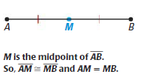
Sec. 1.3: Definitions
Definition of Midpoint:
The midpoint of a segment is the point that divides the segment into two congruent segments.

Slide 2
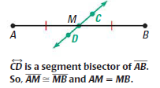
Definition of Segment Bisector:
A segment bisector is a point, ray, line, line segment, or plane that intersects the segment at its midpoint.

Slide 3
Example

Slide 4
Example

