Slide 1
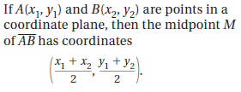
Sec. 1.3: Use Midpoint and Distance Formulas
The Midpoint Formula:

Slide 2
Example
Solution
M = (2.5, -.5)
Solution
K = (3, -2)

Slide 3
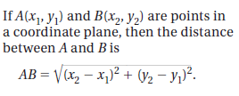
The Distance Formula

Slide 4
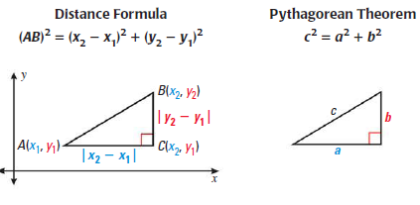
The Distance Formula

Slide 5
Example
C

