Slide 1
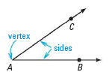
Section 1.4: Measure and Classify Angles
An angle consists of two different rays with the same endpoint.

Slide 2
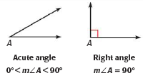
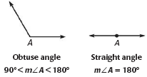
Classifying (Naming) Angles

Slide 3
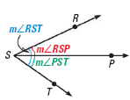
Angle Addition Postulate

Slide 4
Congruent Angles
Two angles are congruent angles if they have the same measure.

Slide 5
Angle Bisector
An angle bisector is a ray that divides an angle into two angles that are congruent.
If bisects ,
then

