Slide 1
Sec. 1.5: Angle Pairs
There are five special pairs of angles:
Adjacent angles
Complementary Angles
Supplementary Angles
Vertical Angles
A Linear Pair

Slide 2
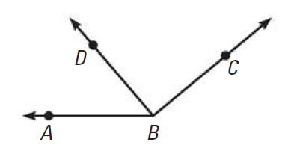
Adjacent Angles
Two angles are adjacent if they share a common vertex and side, but have no common interior points.

Slide 3
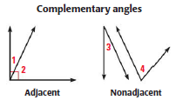
Complementary Angles
Two angles are complementary if their angle measures add up to 90 degrees.
Assuming the measures of angle 3 and 4 above add up to 90 degrees.

Slide 4
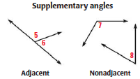
Supplementary Angles
Two angles are supplementary if their angle measures add up to 180 degrees.
Assuming the measures of angle 7 and 8 above add up to 180 degrees.

Slide 5
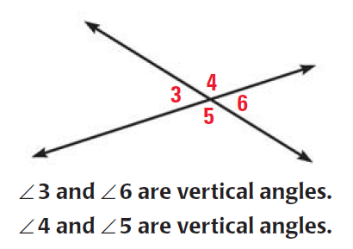
Vertical Angles
Vertical angles are any pair of non-adjacent angles formed by two intersecting lines.

Slide 6
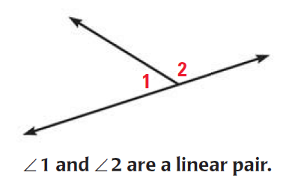
A Linear Pair
A linear pair of angles are adjacent angles whose non-common sides are opposite rays.

