Slide 1
Sec. 2.2: Conditional Statements

Slide 2
Example
Write each conditional statement in “if, then” form.
Three points are collinear if there is a line containing them.
All whales are mammals.
All 90 degree angles are right angles.

Slide 4
Example
Negate the following statements.
A, B, and C are collinear.
A trapezoid is not a parallelogram.

Slide 5
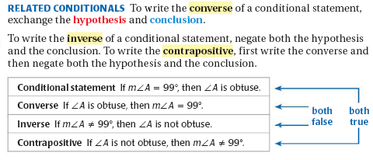

Slide 6
Example

Slide 7
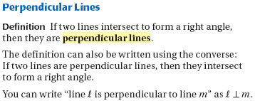
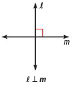

Slide 9
Example
1.
2.

