Slide 1
Sec. 2.4: Use Postulates and Diagrams

Slide 2
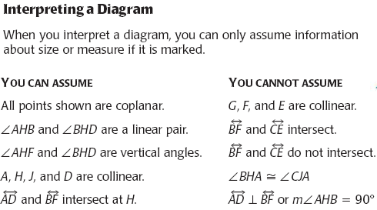

Slide 3
Example 3

Slide 4
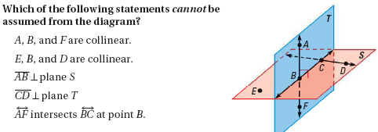
Example 4

Slide 5
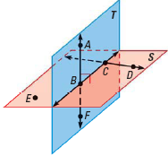
Example 5

