Slide 1
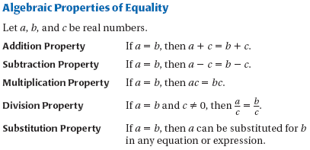
Sec. 2.5: Reason Using Properties from Algebra

Slide 2
Examples

Slide 3
More Properties

Slide 4
More Properties

Slide 5
More Properties

Slide 6
Try These

