Slide 1
Sec. 2.6: Proofs Using Segments and Angles
A proof is a logical argument that shows a statement is true.
In a two-column proof the statements are in the left column and the reasons are in the right.

Slide 2
Example
Given: AB + AB = AC
Prove: AB = BC
Statements Reasons
AB + AB = AC 1. Given
AC = AB + BC 2. Seg. Add. Post.
AB + AB = AB + BC 3. Subst. Prop. =
AB = BC 4. Subtraction Prop. =

Slide 3
Definition of Congruence for Segments
Note: Definitions are biconditional.
Two segments are congruent if and only if they have the same measure.
i.e.

Slide 4
Definition of Congruence for Angles
Two angles are congruent if and only if they have the same measure.
i.e.

Slide 5
A theorem is a statement that can be proven.
Once you have proven a theorem, you can use the theorem as a reason in other proofs.

Slide 8
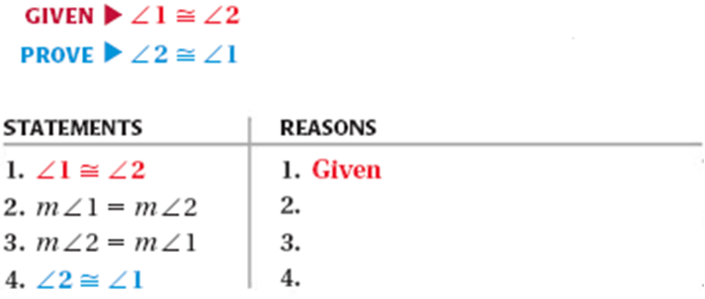

Slide 9
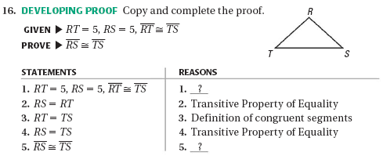
Given
Substitution Prop. =
Definition of Congruent Segments
Transitive Prop. =
Definition of Congruent Segments

