Slide 1
Sec. 2.7: Prove Angle Pair Relationships

Slide 2
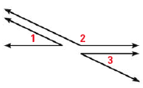
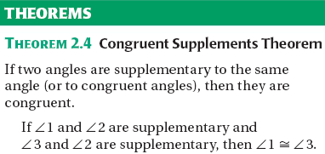

Slide 3
