Slide 1
Sec. 3.1: Identify Pairs of Lines and Angles
Parallel lines are lines in the same plane that do not intersect.

Slide 2
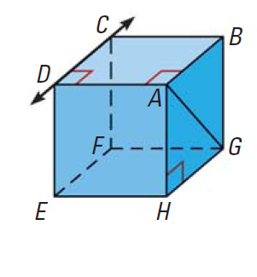
Skew lines are lines not in the same plane that do not intersect.
Line CD and line AG are skew.

Slide 3
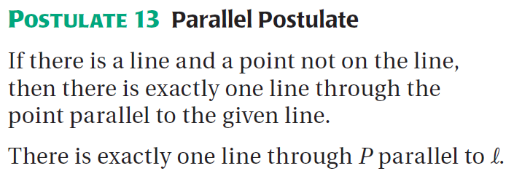
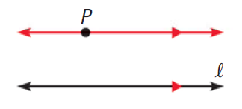

Slide 4
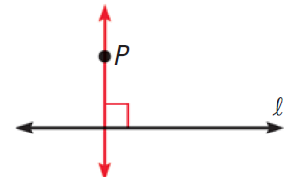

Slide 5
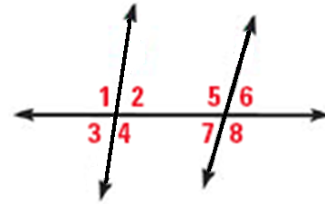
Angles formed by Transversals
A transversal is a line that intersects two or more coplanar lines at different points.
Angles that are between the two lines that are cut by the transversal are called interior angles. Angles 2, 4, 5 and 7 are interior angles.
Angles that are not interior angles are called exterior angles. Angles 1, 3, 6 and 8 are exterior angles.

Slide 6
Special Angle Pairs formed by Transversals
Transversals form special pairs of angles:
Corresponding Angles
Alternate Interior Angles
Alternate Exterior Angles
Consecutive Interior Angles

Slide 8
Examples
Corresponding angles
Alternate Exterior angles
Alternate Interior angles

