Slide 1
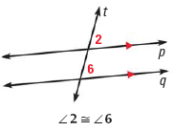
Sec. 3.2: Use Parallel Lines and Transversals

Slide 2
Find the measure of all numbered angles above and then make a conjecture about the other three special angle pairs: alternate interior angles, alternate exterior angle, and consecutive interior angles. What is necessary for your conjectures to be true?

Slide 3
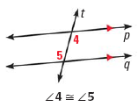

Slide 4
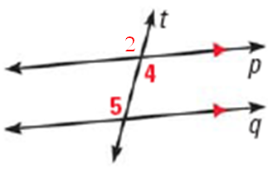
Prove the Alternate Interior Angle Theorem
1. p ||q 1. Given
2. 5  2 2. Corr.  Post.
3. 2  4 3. Vert. s are 
4. 5  4 4. Trans. Prop. 

Slide 5
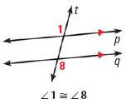

Slide 6
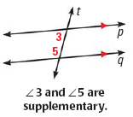

Slide 7
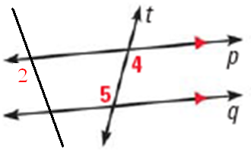
Example
1. p ||q , 2  5 1. Given
2. 5  4 2. Alt. Int.  Thm.
3. 2  4 3. Trans. Prop. 

Slide 8
Example 1

Slide 9
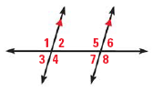
Your Turn

