Slide 1

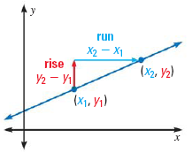
Sec. 3.4: Find and Use Slopes of Lines

Slide 2


Slide 3
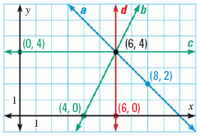
Example
Find the slope of each line in the graph. If undefined, write “undefined.”

Slide 4
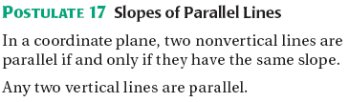
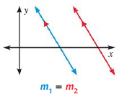

Slide 5
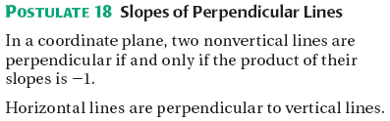
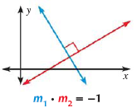

Slide 6
Examples
1.
2.
3. Line h passes through (3, 0) and (7, -6).
What is the slope of any line parallel to h?
What is the slope of any line perpendicular to h?

