Slide 1
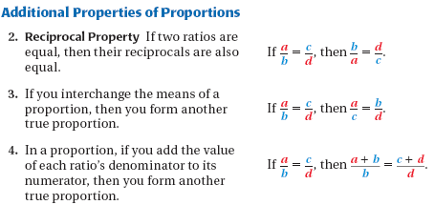
Section 6.2: Using Proportions to Solve Geometry Problems

Slide 2



Example 1

Slide 3

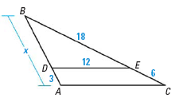
Example 2

Slide 4
Scale Drawing:
A scale drawing is a drawing that is the same shape as the object it represents.
Scale:
The scale of the drawing is the ratio that describes how the dimensions in the drawing are related to the actual dimensions of the object.

Slide 5

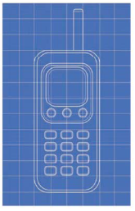
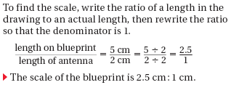
Example 3

