Slide 1

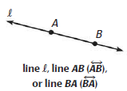
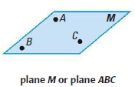
Section 1.1
Undefined Terms: Point, Line, and Plane
Point -
Line -
Plane -

Slide 2
Collinear and Coplanar Points
Collinear Points are points that lie on the same line.
Coplanar Points are points that lie in the same plane.

Slide 3
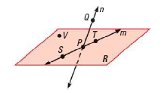

Example 1

Slide 4


Segments and Rays
Segment –
A segment consists of two points, called endpoints, and all points in between.
Ray –
A ray consists of a point, called an endpoint, and all other points along a straight path in one direction away from the endpoint.

Slide 5


Opposite Rays

Slide 6

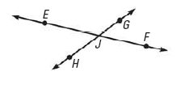
Example 2

Slide 7
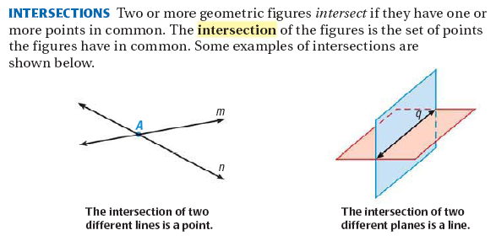

Slide 8

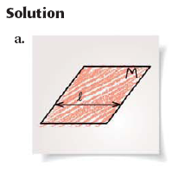
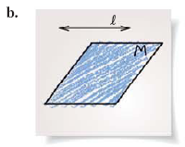
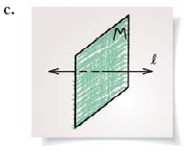
Example 3

Slide 9

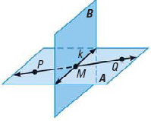

More Practice
1.
2.
3.
4.

